Slide 1

Good Practice Hints & Tips
Handy hints and tips on the best use of TRICS, both for providers and auditors of Transport Assessments
Harry Cook
Operations Officer
Trics consortium ltd
Notes:
In this presentation I am going to take you through some hints and tips on TRICS good practice, taken from our annually updated Good Practice Guide. This is a very important document for users of TRICS which is freely accessible from our website and from within the TRICS database itself. It is aimed at both producers of Transport Assessments and those tasked with auditing them. This document is extensive in nature and covers many elements of good practice, but in this presentation, I have picked out a few handy tips that you should find useful.

Slide 2
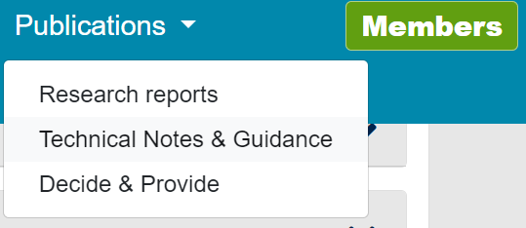

Site Selection by Region, Location Type and Other Data Fields
Region or Location Type?
  TRICS comparative research
  Our results-based guidance
  Extreme exceptions
Notes:
The issue of survey site inclusion or exclusion based on specific regions within the TRICS database has been a subject of concern amongst users. In response, TRICS conducted comparative research into vehicular trip rates, examining both regional variations and the main TRICS location types. This study, conducted in 2019, aimed to identify any significant patterns in trip rate variations attributable to region or location type.
The findings of this vehicular study indicated a notably stronger correlation between trip rates and location type compared to specific regions. Consequently, our current guidance emphasises location type as a primary consideration in filtering criteria, discouraging the exclusion of surveys solely based on their region.
However, it's important to acknowledge extreme exceptions to this general trend. For instance, trip rates from a survey in a city will likely differ from those in more remote areas like the Shetland Islands. Nonetheless, with careful consideration of all pertinent local factors, particularly population density, car ownership levels, and, crucially, location type, there's no apparent reason why trip rates from one area, such as Glasgow, wouldn't be relevant to a development in another, like Greater Manchester.
This highlights the importance of evaluating these factors on a case-by-case basis.

Slide 3
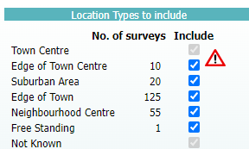
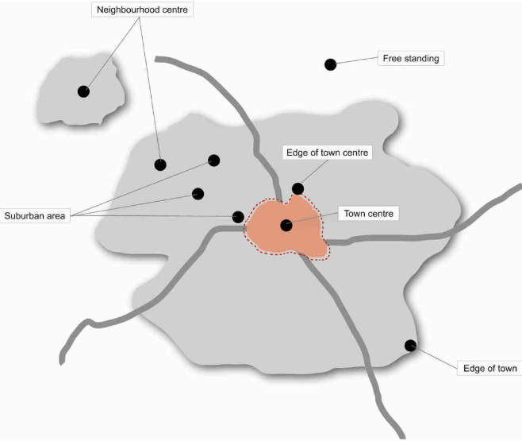
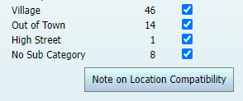
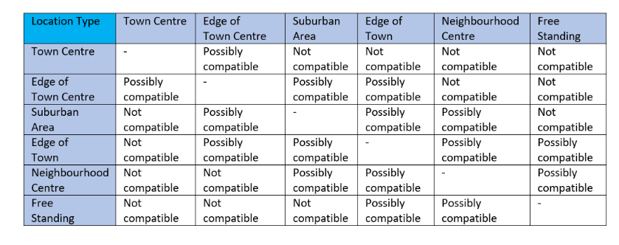

Location Type Categories & Definitions
Notes:
Delving further into the TRICS main location type definitions, it's reasonable to note that developments in town centres may achieve different modal splits compared to those in rural areas. Mixing incompatible sites in a dataset could lead to misleading trip rates. Therefore, TRICS provides a general guide to compatibility by main location type, accessible via the "Note on Location Compatibility" button within the system.
When users select generally incompatible location types simultaneously, a red warning sign indicates this is not good practice. However, it's essential to understand that this tabular guide provides possibilities of compatibility rather than guarantees, with users being required to carefully select their sites considering various factors. It should be noted that the Suburban Area category encompasses a wide range of locations, covering just outside the edge of a town/city centre to more distant suburbs near the edge of a town/city.
To assist in the site selection process, sub-location types are also available for users to provide greater clarity on a site-by-site basis. Harry covered this well in his presentation and full definitions of each location type and subtype is accessible either by clicking the “!” button circled here...

Slide 4


Location Type Categories & Definitions
Notes:
Or by navigating to the Location Type Definitions note via the Technical Notes & Guidance section of the Publications tab on the TRICS main website.

Slide 5
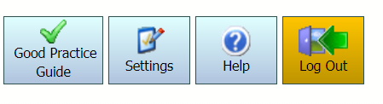
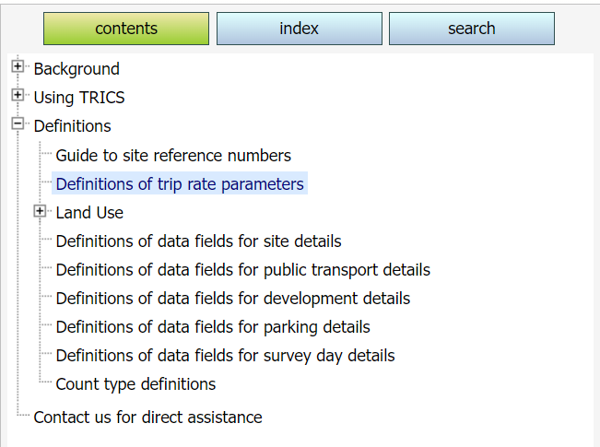
How TRICS Defines Gross Floor Area (GFA)
The independent TRICS definition and where to find it
  The handy Help module
  Other definitions
Land Use Sub-Category exceptions
Considerations when assessing development scenarios
  Identify the definition
  Report any adjustments
Notes:
The TRICS definition for Gross Floor Area (GFA) encompasses the total internal floor area of all building floors, including any mezzanine floors, while excluding service areas. It's important to note that this definition is long-established and independent, which means it may not fully align with definitions used by other organisations. Additionally, slight variations in the definition may exist based on specific land use sub-categories. This definition can be accessed on the system via the Help module here.
For instance, in land use sub-categories like Self-Storage or Commercial Warehousing, external storage areas are also considered part of the GFA. When evaluating development scenarios involving GFA, TRICS users should always be mindful of this definition and its potential exceptions.
If a planning application provides a GFA that differs from the independent TRICS definition, it's essential to consider making reasonable adjustments. These discrepancies should be communicated in reports to prevent any misunderstandings.

Slide 6
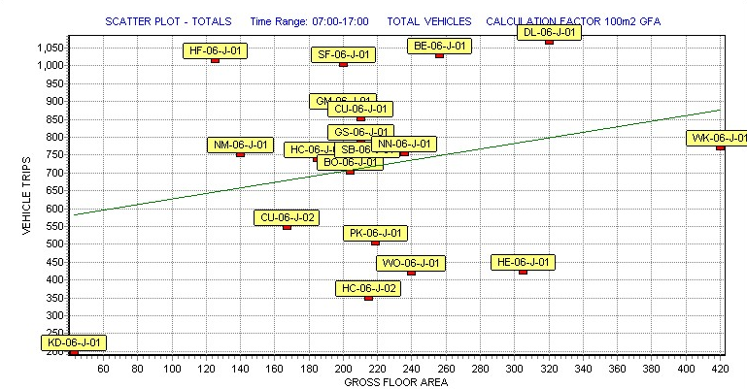
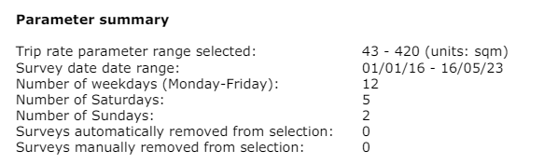

Avoiding the Production of Pre-Determined “Preferred” Trip Rates
The correct procedure
  Inclusively identify criteria
  Acceptable site filtering
  Produce trip rates
Identifying any “manufactured” trip rates to meet a preferred result.
  Rank Order Scatterplot examination
  Parameter Summary
  The TRICS Auditing Facility
Notes:
The approach that TRICS recommends for producing trip rates is to first identify the acceptable criteria ranges for site selection, then filter the sites according to the criteria, and then produce the trip rates once filtering is complete.
Early involvement of all parties involved in trip generation assessment can pre-empt disagreements concerning the suitability of TRICS sites in later stages of the project.
Identifying any trip rates that have been potentially “manufactured” to meet a preferred result is possible involving close examination of TRICS reports using the system itself as an audit. Utilising tools such as rank order scatterplot graphs, accessible through the Scatterplot module, assists in this process. Comparing trip rate results with sites meeting similar criteria offers further possibilities for comparative checking.
The Trip Rate Parameter Summary, which is embedded in trip rate PDF outputs by default, serves as a critical resource for evaluating selections. Its absence may indicate potential issues that warrant further investigation. Engaging all parties involved in the assessment process fosters transparency and helps mitigate potential conflicts.
Further to this, we have the TRICS Auditing Facility…

Slide 7
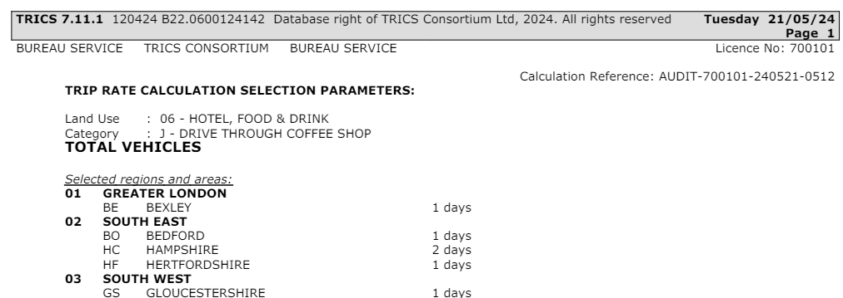

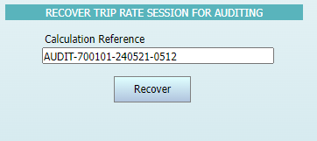
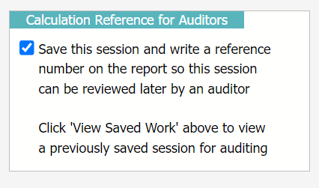
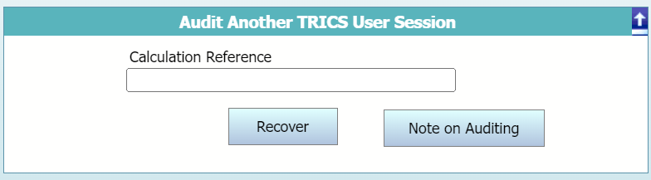
The TRICS Auditing Facility
Notes:
Harry did a good job at covering this in his presentation, but as a quick reminder, audit reference codes are produced by default when creating a PDF output and can be located at the top right corner of each page of the document. If in any case if it does not appear then it has been deselected manually and auditors should attempt to find out the reason for this.

Slide 8
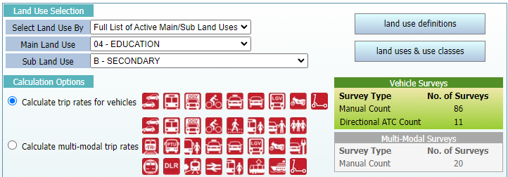
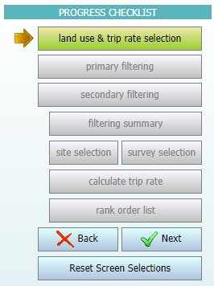
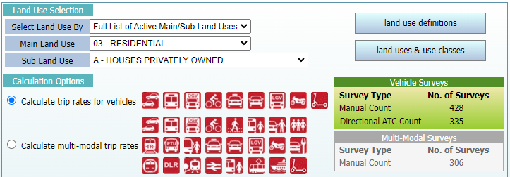
Representative Sample Sizes
Balancing criteria & availability
  Variation of land use popularity
  What is better practice?
  Assessing inclusions & exclusions
Notes:
The TRICS database contains a wide variety of land use sub-categories, each containing their own sets of survey sites. Due to the variation of user popularity and the introduction of new sub-categories, the sets of available data can vary significantly in size.
If you look at the two examples here, you can see that 04/B (Secondary Schools) have a significantly lower number of surveys than 03/A (Houses Privately Owned). Therefore, it is important to maintain a balance when obtaining a representative sample size.
Generally, this balance will involve as many surveys as possible without compromising the effectiveness of inclusion criteria. This ultimately will come down to the user's own professional judgement. However, it is overall considered better practice to be more inclusive than exclusive so to obtain a reasonable survey sample size. It is all about a balance to obtain robustness, and this will differ depending on the land use sub-category being worked on and therefore the amount of available surveys present.
When auditing trip generation results using TRICS, both the exclusion or inclusion of sites that match or do not match criteria respectively should be assessed.

Slide 9

Weighting Factors in Trip Rate Calculations
Identifying potential weighting factors
  Unusual traffic generation
  Trip rate parameter value anomalies
  Influences external to TRICS
Examining outliers & determining the effects
  Scatterplots
  Cross-Testing
  Rank Order lists
Notes:
There are weighting factors that can influence trip rates generated by TRICS. These factors can consist of high or low traffic generation for a site in a set of surveys, a site with a trip rate calculation parameter value, for example, GFA or number of employees, that is significantly higher or lower than other sites in a selected set, or even both.
In addition, potential weighting factors could include influential factors external to TRICS such as economic considerations, demographics, local competition (for retail), and others. TRICS cannot identify specific causes of weighting on a site-by-site basis, so it is down to practitioners to exercise their professional judgement accordingly. However, TRICS surveys do come with a wealth of supporting information which is also very helpful in understanding individual surveyed sites at a good level of detail.
Cross-testing and rank order lists are good tools for identifying potential weighting, and in addition to this, scatterplots can be a good tool for identifying any potential outliers in a dataset. As a quick reminder, this can be accessed via the Scatterplot module within the TRICS system here. As always, we encourage users' professional judgement to be applied, with all surveys in a dataset being valid (including outliers).

Slide 10
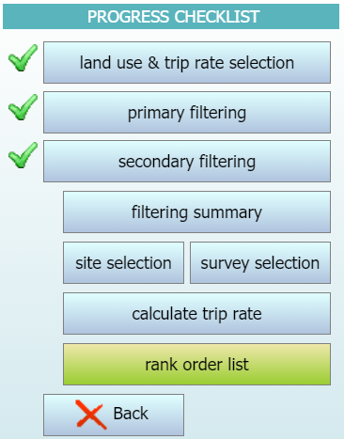
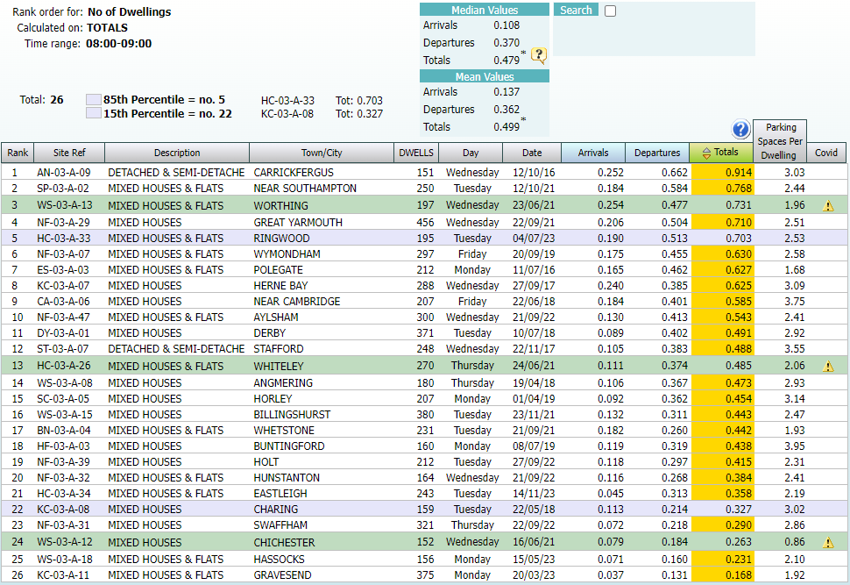
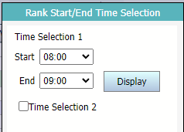
The Rank Order Process
The Rank Order process
  15th & 85th percentiles
  Good percentile practice
Notes:
In this presentation, Harry helpfully explained the TRICS Rank Order process, which provides a list, and not an average, of sites ranked by relative trip rate intensity, also highlighting the 15th and 85th percentile surveys for the specified survey period (should there be sufficient surveys in the selected set). In terms of good practice, it is recognised that there are varying opinions when it comes to the applicability of 15th and 85th percentile trip rates, and TRICS only provides the facility for users, from which they can then apply their professional judgement.
TRICS does recommend that users have at least 20 surveys present within a rank order list before quoting 15th and 85th percentile trip rates in any reports, and in any case where these percentile trip rates are quoted when based on under 20 surveys, it is the user's responsibility to provide evidence for the robustness of these figures.
If there are fewer than 6 surveys, no surveys will be highlighted, and TRICS does not endorse any 15th or 85th percentile figures in such cases. Users that apply their own formulae to obtain these percentiles should present methods in reports and highlight the process that was undertaken outside of TRICS.

Slide 11
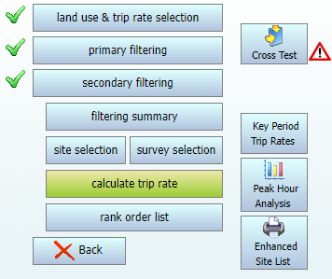
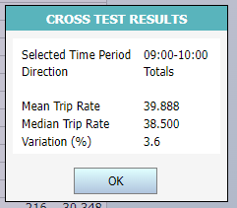
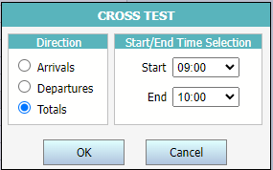
Cross-Testing in TRICS
Notes:
A good way to establish a basic level of weighting in average trip rates, in addition to assisting in identifying the appropriateness of 85th and 15th percentile trip rates, is to use the Cross-Test facility.
In his presentation, Harry explained how to access this tool, but in terms of good practice, it is important to note that in the event of there being a high level of variation, it is recommended that a review of the search criteria should be undertaken to see if the overall number of sites can be increased without significantly compromising any inclusion criteria. It is important to note that it would not be considered good practice to remove any rogue sites based on the results of cross-testing.
Due to the uniqueness of each trip generation scenario, we cannot provide an acceptable variation percentage and therefore professional judgement is required from users. A note accessible to users via a button in this facility explains this in more detail.

Slide 12
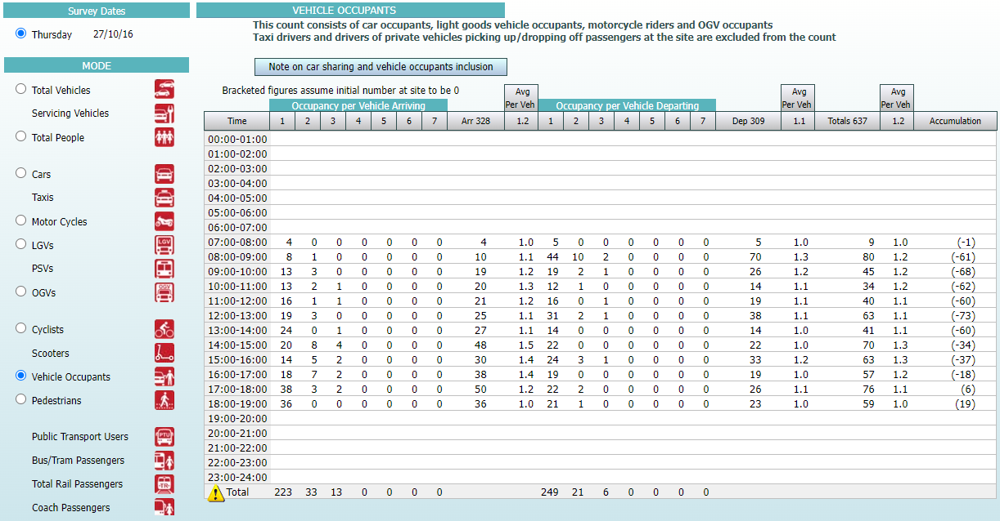
Understanding the TRICS Vehicle Occupants Count
Defining the Vehicle Occupants count
  Inclusions and exclusions
  Taxis
  Exceptions to the rule
Notes:
Based on good practice, it is important to understand the TRICS Vehicle Occupants count. This count includes all occupants of vehicles who are visiting any surveyed site but excludes all drivers of vehicles who are picking up and dropping off passengers at a site (wherever this is possible). This rule applies to occupants of all vehicle types except for bus and coach passengers which are recorded separately.
Note that taxi drivers are treated the same way as drivers of private vehicles who are picking up or dropping off passengers. However, if a driver physically enters a site much like a passenger, then the driver will be included as a vehicle occupant.
For example, if a driver with two passengers arrives at a site, drops them off and then leaves the site. This would be recorded as 1 vehicle arriving and departing and two vehicle occupants arriving. On the other hand, if a driver also visits the site with the passengers after arriving, this would be recorded as 1 vehicle arriving, and 3 vehicle occupants arriving.
It is also important to note that the number of vehicles indicated in a Vehicle Occupants count is often likely to differ from the Total Vehicles count, with the latter recording every vehicle arriving at and departing from a site, whilst the former only records a vehicle if it has at least one occupant (subject to the rules outlined regarding drivers picking up/dropping off passengers).
More detail about this is available on the TRICS system by selecting the note on car sharing pictured here.

Slide 13
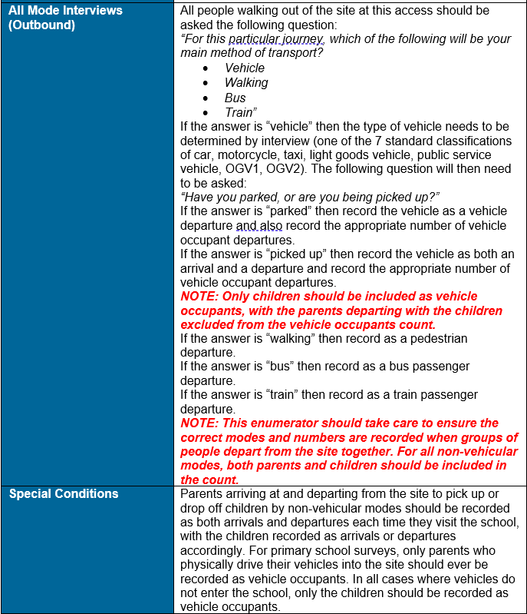
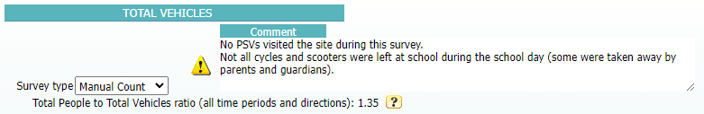

Vehicle Occupants and School Surveys
The rule for multi-modal surveys at schools
  Avoiding over-representation
  Good practice for users
Notes:
The one exception to the general rule is in the case of multi-modal surveys at schools. Any parents or guardians who physically enter the boundaries of a school within a vehicle are included within the Vehicle Occupants count, but any parents or guardians who park anywhere outside a school will not be included unless they are visiting the school for a specific meeting or other event. All school staff parking off-site would also be included as vehicle occupants wherever possible. It should also be noted that all parents or guardians who walk to or from school with their children or use public transport are always included in the appropriate mode within the multi-modal count.
This is designed so that vehicle occupants are not over-represented in multi-modal school surveys. It is considered good practice to include an explanation of this in reports if TRICS is used for the analysis of school sites. Information on this can be accessed via the yellow sign circled here, and through the previously mentioned note on car sharing when using the TRICS system.

Slide 14
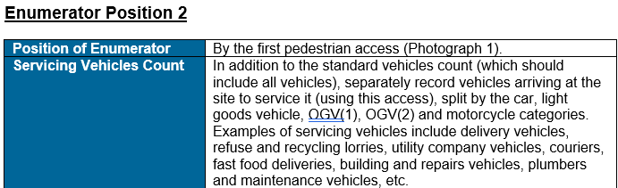
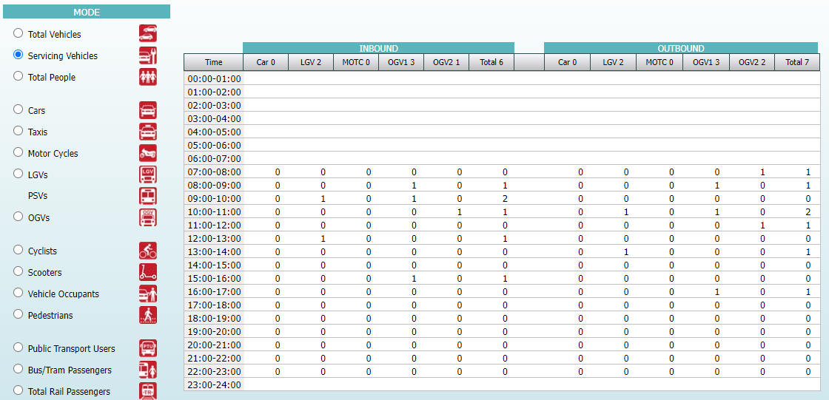
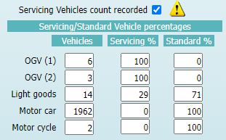
Understanding the TRICS Servicing Vehicles Count
How are Servicing Vehicles counted?
  What is a servicing function?
  Inclusions & exclusions
  An extraction from standard counts
Notes:
Another count type that is important to understand is the TRICS Servicing Vehicles count. This count records all vehicles that arrive at and depart from a site that perform a servicing function. This could for example include deliveries, utility operations, building and maintenance, and fast-food deliveries. The key criteria for a vehicle being included in the Servicing Vehicles count is the function and not the type of vehicle. Vehicles that can be used for servicing that visit a site and do not undertake a servicing function will not be included in this count. Because a high level of certainty is required, you will find that some sites will include a Servicing Vehicles count whilst others will not.
An important point to highlight with the Servicing Vehicles count is how it sits alongside other count types in the TRICS system. Servicing Vehicle counts are not in addition to the standard vehicle types that comprise them. Rather, they are an extract of the standard counts of those types. This can be seen in the box here, showing the standard and servicing percentage splits.
This box indicates whether a Servicing Vehicles count was included in a survey, if the box is ticked and there is no Servicing Vehicles count visible, it means that a count was undertaken but no vehicles serviced the site during that survey. If the box is un-ticked it means that a Servicing Vehicles count was not included in the survey. However, this does not indicate that no vehicles serviced the site; it just means that such vehicles could not be identified with a high enough level of confidence due to the nature of the survey that was undertaken.
Further detail on the Servicing Vehicles count can be accessed via the yellow icon circled here.

Slide 15
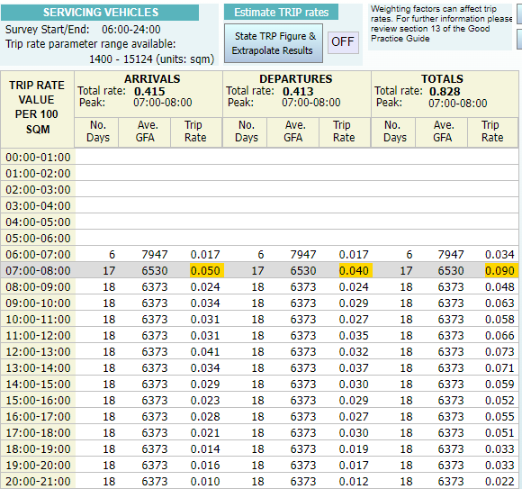
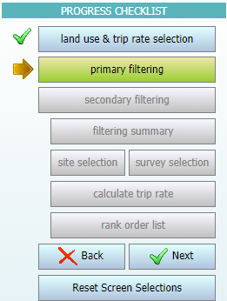
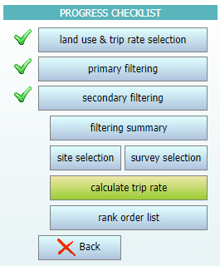


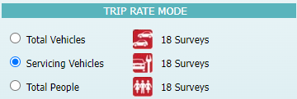
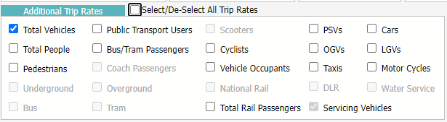
Calculating Servicing Vehicle Trip Rates
Notes:
Users can calculate trip rates for Servicing Vehicle counts in the same way as they can for all other TRICS count types. It should be noted that the same rules apply for Servicing Vehicles as for other count types, in that for a calculation to be undertaken all surveys in a selected set must have the Servicing Vehicles count included.
To assist in this, within the Primary Filtering stage of the trip rate calculation selection process, users can select surveys where the Servicing Vehicles count has been included or excluded.

Slide 16
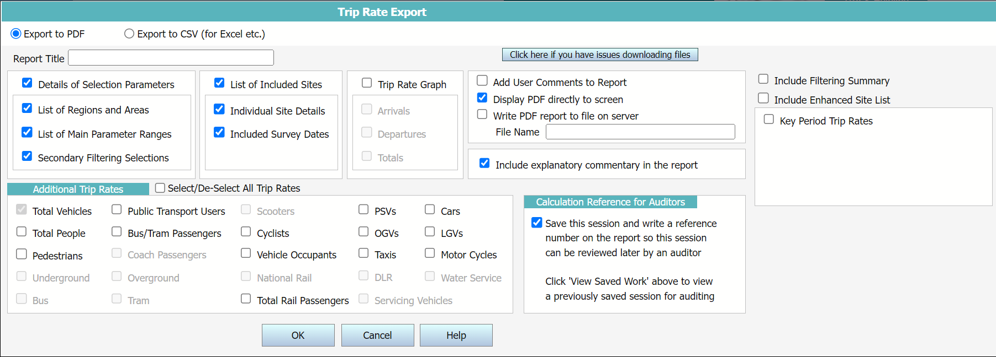
Correct Presentation of Trip Rates and Methods
Good practice in reports
  Details of selections made
  Results clearly explained
  Identification of users
Notes:
Reports should detail the methods used to obtain data from TRICS, allowing recipients and auditors to fully understand and verify the findings. This transparency is crucial, especially for audits by organisations without TRICS access, ensuring they can understand the results without independent analysis.
Trip rates generated by TRICS should be fully contextualised in reports, specifying details like the survey period, direction, and calculation factor. Reports should also clearly state the version of TRICS used to obtain trip rate results. Note that TRICS PDF outputs include the version number at the top of each page.
Auditors should ensure TRICS PDF outputs display the generating organisation's name and TRICS licence number. Missing or incorrect details may indicate a copyright breach, which should be reported to TRICS Consortium Limited. It is important to note that unauthorised TRICS data makes reports inadmissible.

Slide 17
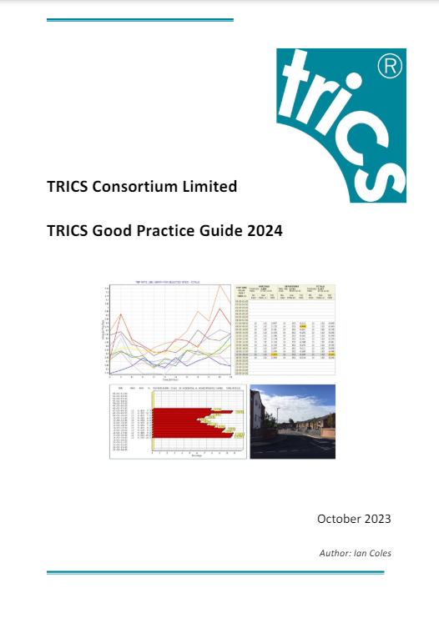


TRICS Good Practice Guide
Notes:
Here is where the TRICS Good Practice Guide can be accessed.

